Slide 1
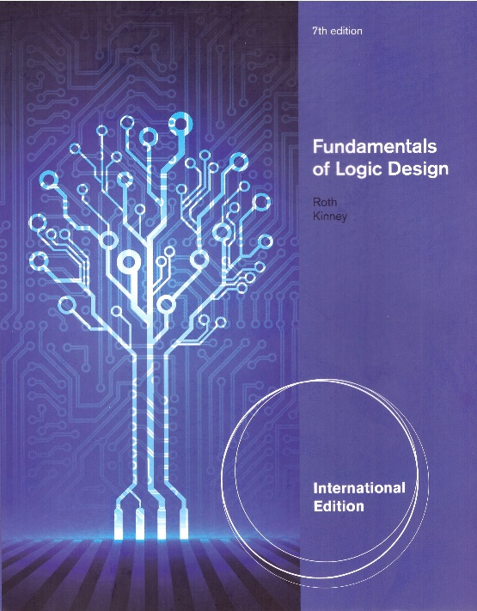
Unit 3
BOOLEAN ALGEBRA (continued)
This chapter in the book includes:
Objectives
Study Guide
3.1 Multiplying Out and Factoring Expressions
3.2 Exclusive-OR and Equivalence Operations
3.3 The Consensus Theorem
3.4 Algebraic Simplification of Switching expressions
3.5 Proving the Validity of an Equation
Programmed Exercises
Problems

Slide 2
Objectives
Topics introduced in this chapter:
Apply Boolean laws and theorems to manipulation of expression
Simplifying
Finding the complement
Multiplying out and factoring
Exclusive-OR and Equivalence operation(Exclusive-NOR)
Consensus theorem

Slide 3
3.1 Multiplying Out and Factoring Expressions
To obtain a sum-of-product form ➔ Multiplying out using distributive laws
Theorem for multiplying out
(
X
+
Y
)(
X
'
+
Z
)
=
XZ
+
X
'
Y
(3-3)
If
X
=
0,
(3
-
3)
reduces
to
Y(1
+
Z)
=
0
+
1
∗
Y
or
Y
=
Y.
If
X
=
1,
(3
-
3)
reduces
to
(1
+
Y)Z
=
Z
+
0
∗
Y
or Z
=
Z.
Because
the
equation
is
valid
for
both
X
=
0
and
X
=
1,
it
is
always
valid.

Slide 4
3.1 Multiplying Out and Factoring Expressions
Theorem for multiplying out
(
Q
+
AB
'
)(
C
'
D
+
Q
'
)
=
QC
'
D
+
Q
'
AB
'
Multiplying out using distributive laws
Redundant terms
Multiplying out: use distributive laws and theorem (3-3)
(
A
+
B
+
C
'
)(
A
+
B
+
D
)(
A
+
B
+
E
)(
A
+
D
'
+
E
)(
A
'
+
C
)
=
(
A
+
B
+
C
'
D
)(
A
+
B
+
E
)[
AC
+
A
'
(
D
'
+
E
)]
=
(
A
+
B
+
C
'
DE
)(
AC
+
A
'
D
'
+
A
'
E
)
=
AC
+
ABC
+
A
'
BD
'
+
A
'
BE
+
A
'
C
'
DE
(3-4)

Slide 5
3.1 Multiplying Out and Factoring Expressions
To obtain a product-of-sum form ➔ Factoring using distributive laws
Theorem for factoring
A
B
+
A
'
C
=
(
A
+
C
)(
A
'
+
B
)
Example
AC
+
A
'
BD
'
+
A
'
BE
+
A
'
C
'
DE
=
AC
+
A
'
(
BD
'
+
BE
+
C
'
DE
)
XZ
X
'
Y
=
(
A
+
BD
'
+
BE
+
C
'
DE
)(
A
'
+
C
)
=
[
A
+
C
'
DE
+
B
(
D
'
+
E
)](
A
'
+
C
)
X
Y
Z
=
(
A
+
B
+
C
'
DE
)(
A
+
C
'
DE
+
D
'
+
E
)(
A
'
+
C
)
=
(
A
+
B
+
C
'
)(
A
+
B
+
D
)(
A
+
B
+
E
)(
A
+
D
'
+
E
)(
A
'
+
C
)
(3-5)

Slide 6
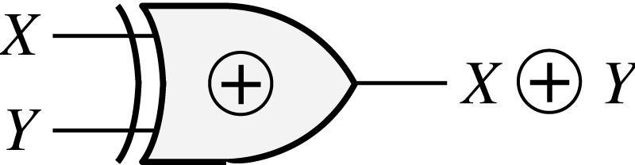
3.2 Exclusive-OR and Equivalence Operations
Exclusive-OR
Truth Table
XY
0 0
0 1
1 0
1 1
0
1
1
0
Symbol
Notes:
magnetics

Slide 7
3.2 Exclusive-OR and Equivalence Operations
Theorems for Exclusive-OR

Slide 8
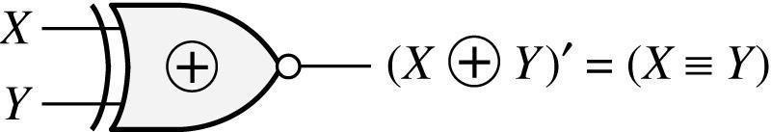
3.2 Exclusive-OR and Equivalence Operations
Equivalence operation
(Exclusive-NOR)
Truth Table
XY
0 0
0 1
1 0
1 1
1
0
0
1
Symbol
Notes:
shocks

Slide 9
3.2 Exclusive-OR and Equivalence Operations
Example of XOR and Equivalence
Useful theorem
(3-19)
(by (3-6))
(by (3-19))

Slide 10
3.3 The Consensus Theorem
Consensus Theorem
Proof
Example
consensus
consensus
Dual form of consensus theorem
Example

Slide 11
3.3 The Consensus Theorem
Example: eliminate BCD
Example: eliminate A’BD, ABC
Example: Reducing an expression
by adding a term and eliminate
Consensus
Term added
Final expression

Slide 12
3.4 Algebraic Simplification of Switching Expressions
1. Combining terms
Example
2. Eliminating terms
Example

Slide 13
3.4 Algebraic Simplification of Switching Expressions
3. Eliminating literals
Example
4. Adding redundant terms (Adding xx’, multiplying (x+x’), adding yz to xy+x’z, adding xy to x, etc…)
Example
(add WZ’ by consensus theorem)
(eliminate WY’Z’)
(eliminate WZ’)
(3-27)

Slide 14
3.5 Proving Validity of an Equation
Proving an equation valid
1. Construct a truth table and evaluate both sides – tedious, not elegant method
Manipulate one side by applying theorems until it is the same as the other side
Reduce both sides of the equation independently
Apply same operation in both sides ( complement both sides, add 1 or 0 )

Slide 15
3.5 Proving Validity of an Equation
Prove
(add consensus of A’BD’ and ABC’)
(add consensus of A’BD’ and BCD)
(add consensus of BCD and ABC’)
(eliminate consensus of BC’D’ and AD)
(eliminate consensus of AD and A’BC)
(eliminate consensus of BC’D’ and A’BC)

Slide 16
3.5 Proving Validity of an Equation
Some of Boolean Algebra are not true for ordinary algebra (philosophy)
Example
True in ordinary algebra
Not True in Boolean algebra
Example
True in ordinary algebra (if x ≠ 0)
Not True in Boolean algebra
Example
True in ordinary algebra
True in Boolean algebra

